Slide 1
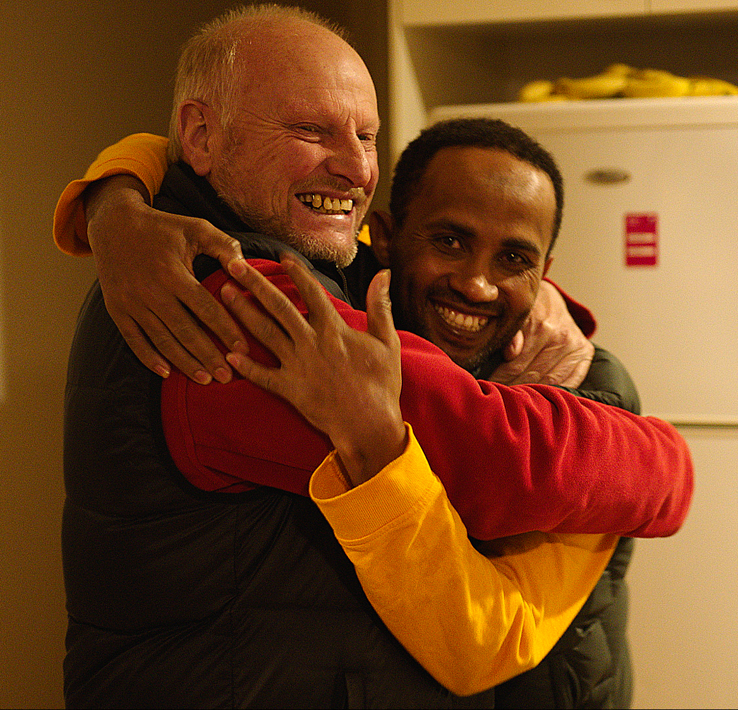
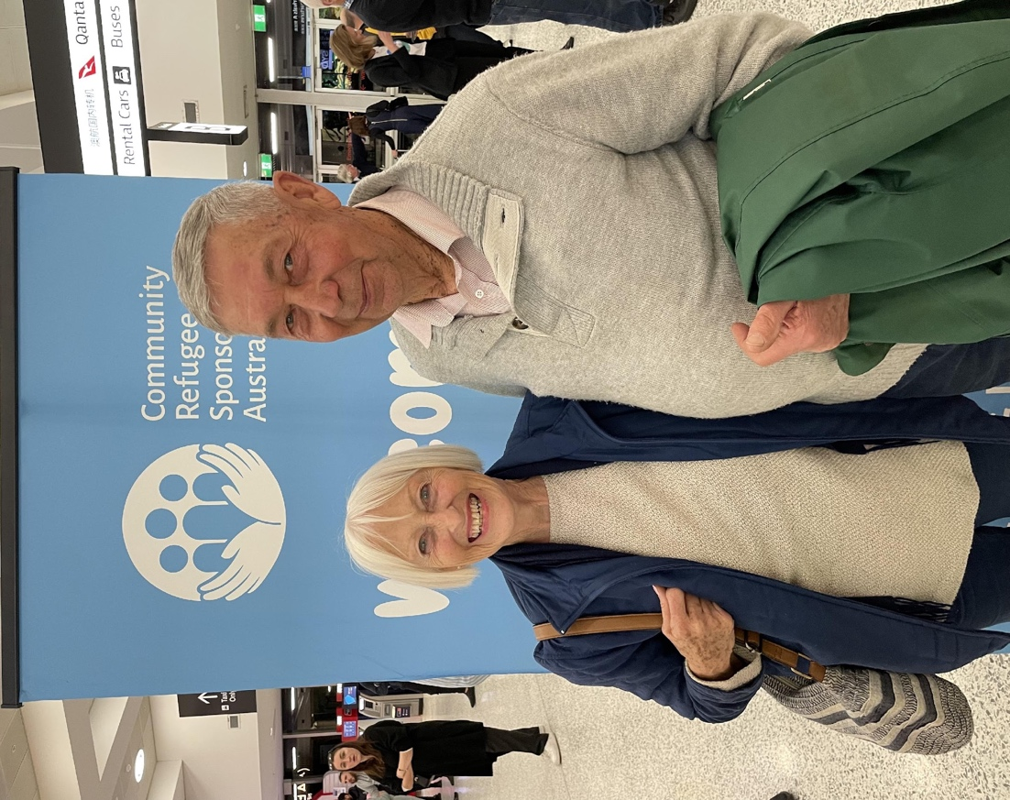
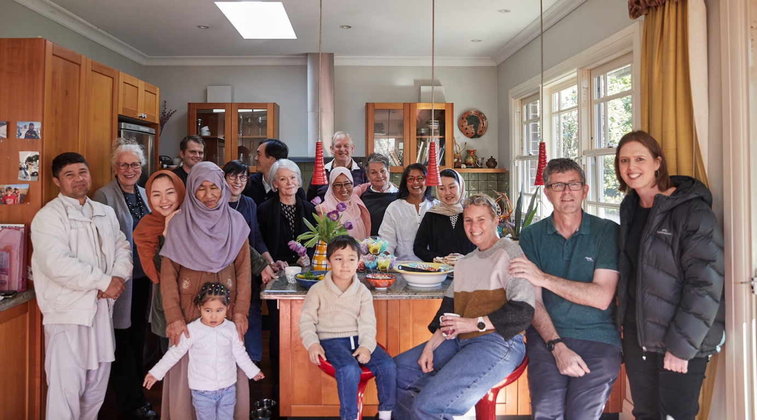
A new way for Australia to say ‘welcome’

Slide 2
The global refugee challenge
100M Forcibly displaced people
21.3M Of these are refugees
2M Urgently need resettlement
~100K /year resettled worldwide
No way to address the global refugee challenge through local volunteering
Everyday Australians want to help, but:
No framework to meet refugee newcomers & offer ongoing help

Slide 3
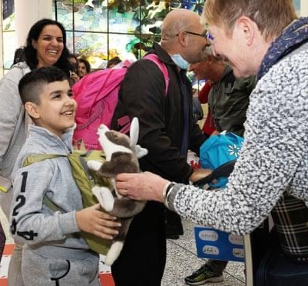
The answer: community sponsorship
Empowering locals to support newcomers to settle & integrate by providing social, material & practical support.
Canada: 325,000 people resettled over 40 years via community sponsorship - in addition to government-supported refugees.
Australia: Government plans to enlarge Australia’s response by 5,000 sponsored refugee places that will be additional to the current resettlement quota.

Slide 4
What is community sponsorship?

Slide 5
Who is CRSA?
An independent national charity
Our vision: To lead in encouraging, developing and supporting programs that expand and improve refugee settlement in Australia by harnessing the generosity, goodwill and social capital of groups of everyday Australians.
Currently delivering the new federal government-backed Community Refugee Integration & Settlement Pilot (CRISP). Also supported by private philanthropy and corporate donations.

Slide 6
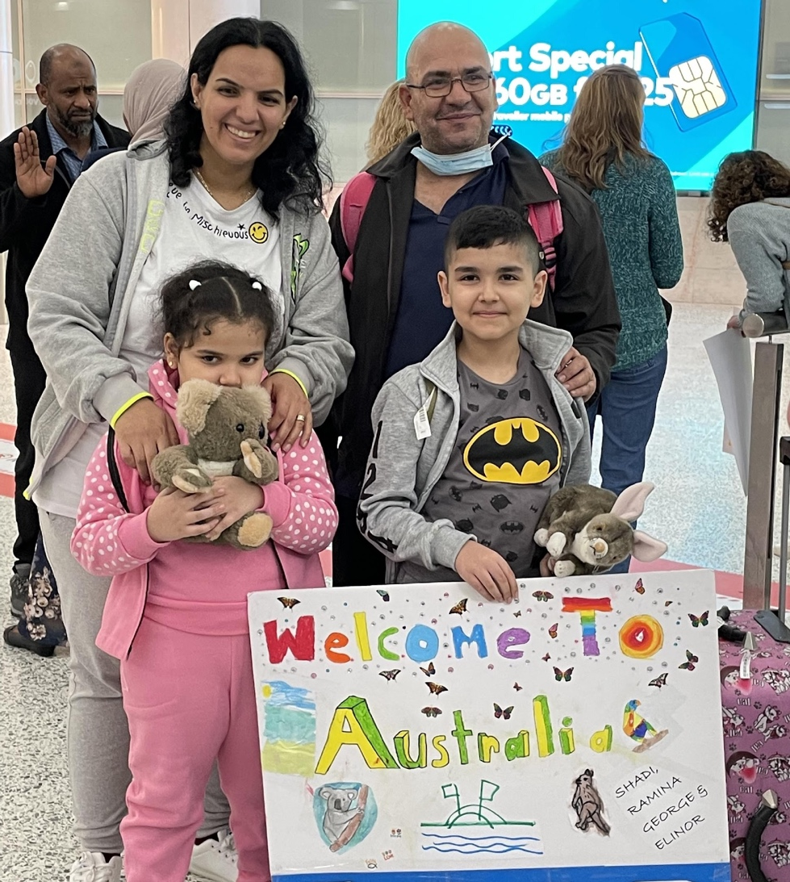
Everyday Australians helping newcomers overcome key barriers
LANGUAGE
NETWORKS
QUALIFICATION RECOGNITION
EDUCATION
TRAUMA
“When we met the group we thought, now we have family here!”
Fatima, GMP Mentee
WORK OPPORTUNITIES
A group of 5+ local volunteers use existing relationships & rich social capital to help new arrivals navigate unfamiliar situations and systems.

Slide 7
What it takes to get involved
Form a group of 5 or more adults
Able to give combined 10+ hours a week
And raise funds for arrival needs
Group coordinator fills in form
Match with a refugee household
Background checks
Onboarding completed
Training & peer learning
Templates & plans
CRSA support

Slide 8
Who does what?
Local supporter groups
Refugee newcomers
Communicate needs, aspirations and challenges
Plan | Fundraise | Find housing | Meet at airport
Tailored ongoing support, eg:
Match
& Monitor
Actively engage with group
Paperwork | Driving lessons | Employment | Education
Screen
Train
Support
Empower
Receive UNHCR referral via Gov’t
CRSA

Slide 9
Create shared purpose & pride
WAYS YOUR ORGANISATION CAN HELP
Nurture a local supporter group
Fund a local supporter group
Raise awareness of the program
Provide training or job opportunities
Provide/donate goods, services or vouchers
HOW YOU BENEFIT
Build a diverse, connected community
Be a part of a local group’s work
And part of a growing global movement

Slide 10
We need your help!
Fund your local supporter group & help us pay for:
Rent
Household goods and appliances
Initial income support
Essential items and contingencies, e.g. seasonal clothing, emergency healthcare, phone and phone plan
All donations over $2 are tax deductible

Slide 11
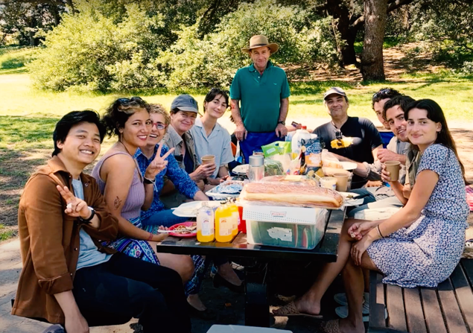
Thank you for your time
INTERESTED?
Insert your call to action, group’s contact information or anything else you’d like to leave with your audience here.
A group shot can be helpful too.
“If it takes a village to raise a child, it takes a village to help a family settle in!”
Mandy, local supporter group
For more information on the ‘CRISP’: refugeesponsorship.org.au
The CRISP is funded by the Australian Government Department of Home Affairs Photo credits: CRSA | The Australian Women’s Weekly | Alana Landsberry

